Slide 1
University American College Skopje
Course: Business Computer Applications
Application of NextGen AI composers (ChatGPT) in learning
Marija Stanojeska, PhD

Slide 2
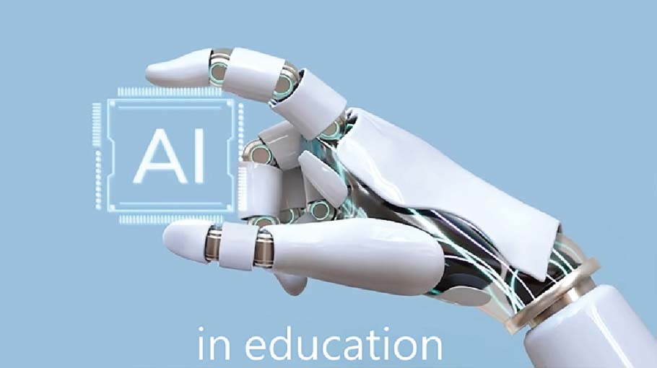

Slide 3
Lecture overview
Explanation of the role of AI composers, specifically ChatGPT.
Discussion the evolution of AI in education.
Explanation of the practical applications in learning.
Discussion about the ethical aspects of using AI in education.
Traditional vs. adaptive education discussion.
Analyze of benefits of inclusion of AI in education.

Slide 4

Introduction
  Artificial Intelligence (AI) is transforming various industries, and education is no exception.
  With advancements in AI, particularly in Natural Language Processing (NLP), tools like ChatGPT have emerged as powerful partners in the learning process.
  The role of AI composers, specifically ChatGPT, in transforming writing and learning will be explored, and the practical applications and ethical considerations that educators and students must be aware of will be discussed.

Slide 5
AI tools in writing
  AI tools like ChatGPT are designed to assist and enhance the writing process. They can generate content, suggest improvements, and even help with research by providing relevant information quickly.
  These tools are not just limited to writing; they can also aid in:
  learning languages,
  brainstorming ideas,
  improving grammar.
  Popular AI tools include:
  ChatGPT for content generation,
  Grammarly for grammar checks, and
  Quillbot for paraphrasing.

Slide 6
Evolution of AI in education
  The integration of AI into education has been a gradual process.
  Initially, AI was used for simple tasks like grading and providing personalized learning paths. However, with advancements in AI technology, its applications have expanded significantly.
  Today, AI can engage in sophisticated tasks such as tutoring, content creation, and even emotional recognition to provide support to students.
  The role of machine learning and NLP has been crucial in this evolution, enabling AI tools to understand and generate human-like text.

Slide 7
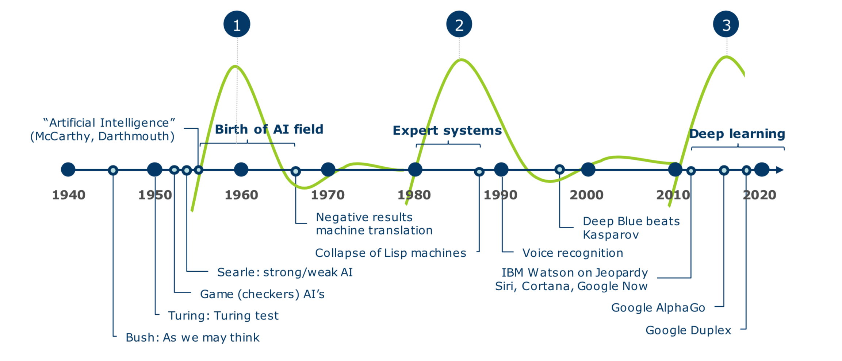
Evolution of AI in education illustration

Slide 8
How AI composer work
  AI composers like ChatGPT are powered by large language models (LLMs) that have been trained on vast amounts of text data.
  These models learn patterns in language, enabling them to generate coherent and contextually appropriate text.
  When you input a prompt, the AI analyzes it and generates a response based on its training.
  The more complex the model, the better it can understand and produce text that is both relevant and accurate.
  This ability to generate text has opened new possibilities in education, where AI can assist students in a variety of writing tasks.
https://www.youtube.com/watch?v=bSvTVREwSNw
https://www.youtube.com/watch?v=4qGrteTY1EM

Slide 9
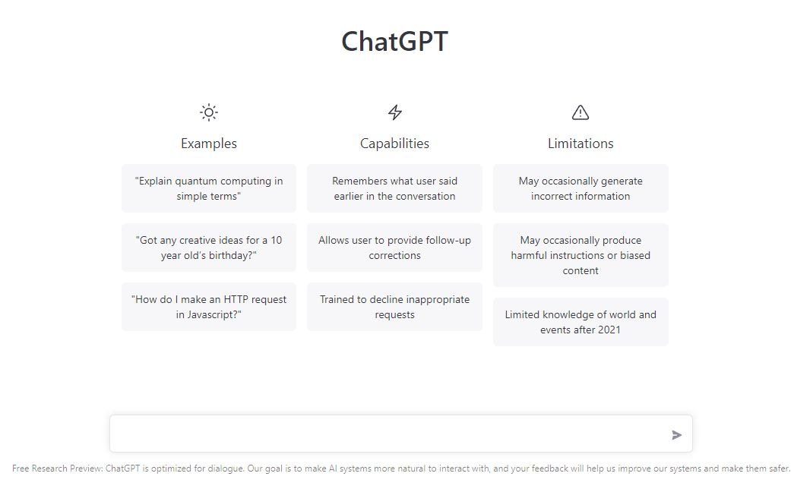
Illustration

Slide 10
Practical applications in learning
AI tools like ChatGPT are transforming how students approach writing assignments. They can generate entire essays, research papers, and reports, offering students a starting point or helping them overcome writer's block. AI can also be used for brainstorming, providing students with ideas or alternative perspectives on a topic.
Furthermore, AI tools are valuable in language learning, as they can provide instant grammar corrections and suggest improvements in real-time. Effective communication is essential for academic success and future-readiness, yet many students struggle with confidence in these skills. Chat GPT can support language learning, communication and comprehension by providing interactive and immersive language practice. For instance, in foreign language classes, ChatGPT can engage students in conversational practice in various languages, helping them improve their speaking and listening skills. The AI can simulate real-life conversations and provide instant feedback. It also offers a “read aloud” setting that lets the student hear the pronunciation of words they may be struggling with. This interactive approach can boost students’ confidence in using a new language and accelerate their learning process.
ChatGPT can also assist with grammar and vocabulary exercises, reading comprehension and writing practice. By offering personalized feedback and tailored exercises, ChatGPT can help students become more proficient and confident communicators.

Slide 11
AI in collaborative learning
  AI tools are not just for individual use; they can also enhance collaborative learning experiences.
  In group projects, AI can facilitate communication by generating content that can be reviewed and edited by the group. It can also act as a peer-review tool, providing feedback on drafts before they are finalized.
  By analyzing AI-generated content, students can develop critical thinking skills, learning to evaluate and refine ideas presented by the AI. This collaborative approach ensures that AI is integrated into the learning process in a way that benefits all participants.

Slide 12
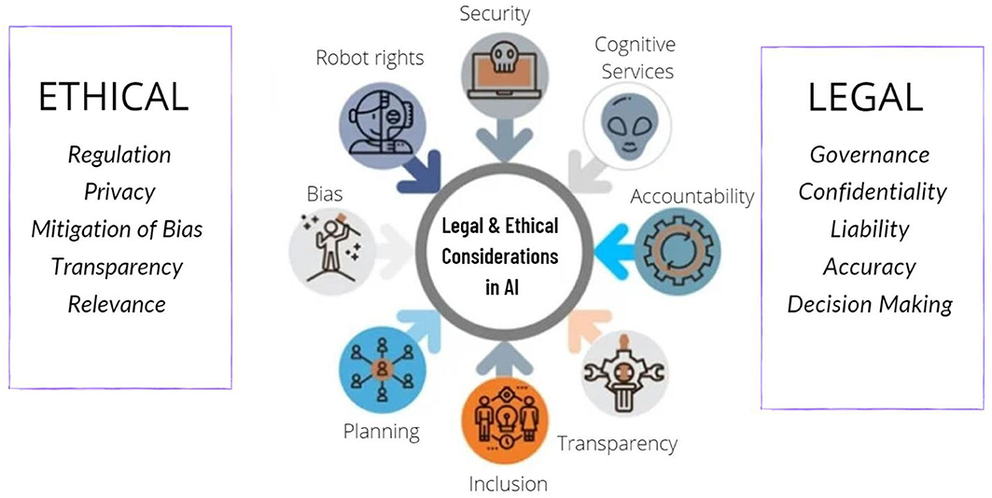
Ethical consideration
  While AI offers many benefits, there are also ethical concerns that must be addressed. One major issue is academic integrity. T
  he comfort with which AI can generate content raises the risk of plagiarism, as students might be tempted to submit AI-generated work as their own.
  Additionally, there is a concern about over-reliance on AI, where students might rely too heavily on these tools and abandonment developing their own writing skills.
  Ethical concerns also extend to data privacy and AI bias, as these tools are trained on data that may contain biases or sensitive information.
  It's crucial that educators and students use AI responsibly and understand its limitations.

Slide 13
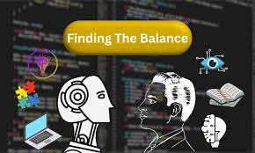
Balancing AI and human creativity
  AI should be seen as a complement to human creativity, not a replacement. While AI can generate content and provide ideas, the creative process still requires human input to be truly effective.
  Educators should encourage students to use AI as a tool to enhance their work, rather than as a crutch.
  By combining the strengths of AI with human creativity, students can produce higher quality work and develop a deeper understanding of their subjects.
  Examples of successful collaboration between AI and human input can help illustrate this balance.

Slide 14
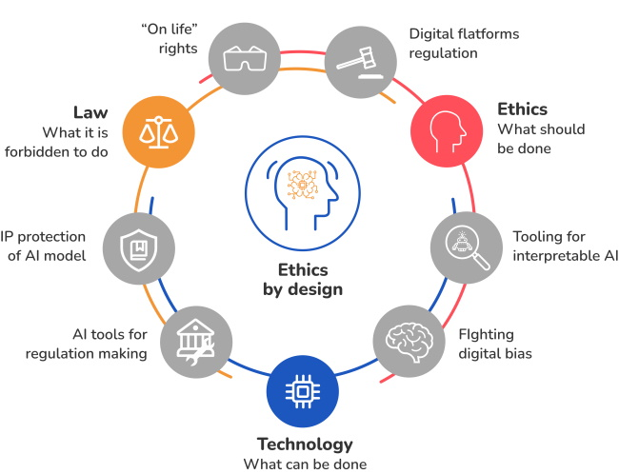
Guidelines for ethical AI use in education
  To ensure ethical use of AI in education, it's important to establish clear guidelines. Students should be taught how to use AI tools responsibly, understanding when and how to use them effectively.
  Proper citation of AI-generated content is crucial to maintain academic integrity. Educators should also develop policies that outline acceptable use of AI in assignments and assessments.
  By providing students with the right guidance, we can ensure that AI is used as a valuable resource in education rather than a shortcut.

Slide 15
Teaching support and professional development
As well as academic support for students, ChatGPT offers significant advantages for teachers. Educators can leverage ChatGPT to enhance their teaching methods, brainstorm new exercises or applications, manage administrative tasks and engage in professional development.
ChatGPT can assist teachers in creating lesson plans, generating educational materials and designing assessments. By automating these time-consuming tasks, teachers can focus more on delivering high-quality instruction and providing individualized attention to their students.
ChatGPT can also serve as a professional development tool for teachers. Educators can use the AI to stay updated on the latest educational trends, research and best practices. ChatGPT can also facilitate peer collaboration by connecting teachers with experiences, ideas, and advice shared by colleagues around the world.

Slide 16
Enhancing critical thinking and analytical skills
Developing critical thinking and analytical skills is fundamental to future-readiness in education. These skills are essential for problem-solving, decision-making and understanding complex concepts. ChatGPT can enhance students’ critical thinking abilities by engaging them in thought-provoking discussions and activities.
For example, ChatGPT can facilitate debates on various topics, encouraging students to articulate their viewpoints, analyze opposing arguments and defend their positions. These activities help students develop logical reasoning and persuasive communication skills.
Additionally, ChatGPT can help to support computational thinking by presenting students with challenging problems and guiding them through the process of breaking down the problem, analyzing data and formulating solutions. This hands-on approach to problem-solving helps students develop a structured and analytical mindset, preparing them for future academic and professional endeavors.

Slide 17
Addressing diverse learning needs
The classrooms are diverse environments, with students exhibiting a wide range of learning needs and abilities. ChatGPT could help address this diversity by offering differentiated instruction and support. For example, students with special educational needs can benefit from the personalized attention and tailored experiences provided by ChatGPT.
Additionally, ChatGPT can support English language learners by providing language support, vocabulary support and cultural context. This targeted assistance can help students overcome language barriers and succeed academically.

Slide 18
Future trends and innovation
  The field of AI is rapidly evolving, and new innovations are constantly emerging.
  In the future, we can expect AI to become even more integrated into the educational process, with tools that are more personalized and adaptive to individual learning styles.
  Virtual tutors powered by AI could provide real-time assistance to students, while AI-driven analytics could offer educators deeper insights into student performance.
  While many see ChatGPT as muting creativity and innovation, it can instead be used as a tool to bolster creativity. For instance, ChatGPT can engage students in creative writing exercises, brainstorming sessions and interactive storytelling, encouraging them to think outside the box and explore new ideas.
  Additionally, AI such as ChatGPT can assist in creative problem-solving exercises, such as designing experiments or developing solutions to real-world problems. By guiding students through the brainstorming process and offering diverse perspectives, ChatGPT can help cultivate innovative thinking and prepare students for future challenges.

Slide 19
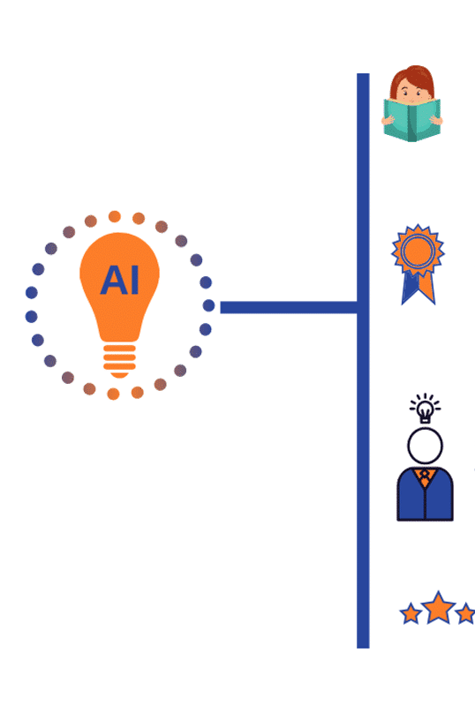
Personalized “Tutoring” and adaptive learning
While almost every student could benefit from personal tutoring, this isn’t always within the bandwidth of teachers or administrators. However, with careful use of AI such as ChatGPT, it can be possible to provide one-on-one support in a more scalable environment.
For instance, a student can use ChatGPT to answer questions in real-time, provide additional explanations, or even re-word explanations when they don’t make sense to a student. Teachers can also use ChatGPT to provide personalized exercises, examples, practice questions and more for individual students.
Analyzing students learning patterns
Designing specific courses
Providing suggestions for any gaps in learning
Tracking student progress

Slide 20
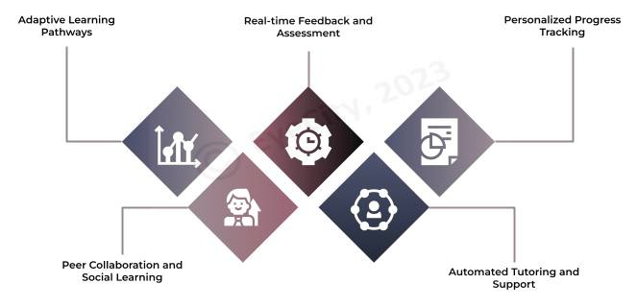
How AI is used to personalize learning
Adaptive learning pathways
Real-time feedback and assessment
Personalized progress tracking
Peer collaboration and social learning
Automated tutoring and support

Slide 21
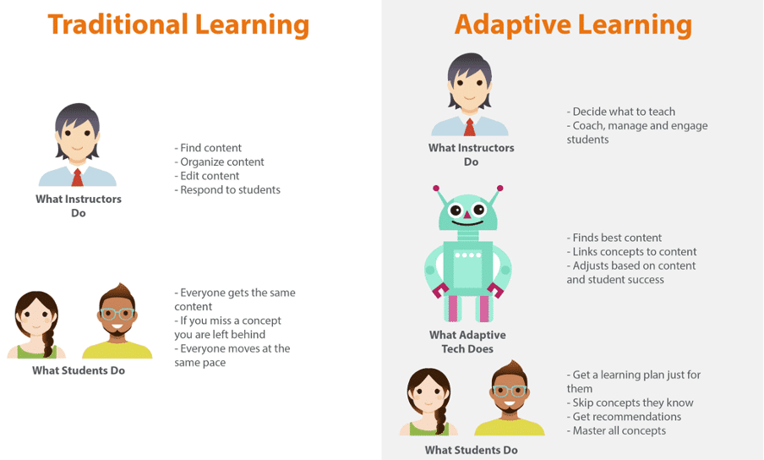
Traditional vs. Adaptive learning

Slide 22
Final thoughts…
However, critics worry that the ease with which students can use ChatGPT to generate essays, solve problems and complete assignments may lead to an increase in academic dishonesty. They fear that reliance on AI-generated content might undermine the development of critical thinking and writing skills, as students may be tempted to pass off AI-produced work as their own.
This debate is further complicated by the rapid advancement and accessibility of AI technologies. Educators and institutions are grappling with the challenge of integrating these tools into curriculum in ways that maximize their educational benefits while minimizing the risks of misuse.
In conclusion, AI composers like ChatGPT are powerful tools that have the potential to transform the way we approach writing and learning. It's important to use these tools responsibly, keeping in mind the ethical considerations and the need for human oversight.
While ChatGPT and other widely available AI technologies bring new challenges and considerations in education, it also has the potential to enhance an engaging educational experience when used strategically and conscientiously.
As technology continues to evolve, the role of AI in education will undoubtedly expand, offering new opportunities to enrich the student experience and prepare the next generation for success in an ever-changing world.

Slide 23
Conclusion
  In conclusion, AI composers like ChatGPT are powerful tools that have the potential to transform the way we approach writing and learning.
  However, it's important to use these tools responsibly, keeping in mind the ethical considerations and the need for human oversight.
  While ChatGPT and other widely available AI technologies bring new challenges and considerations in education, it also has the potential to enhance an engaging educational experience when used strategically and conscientiously.
  As technology continues to evolve, the role of AI in education will undoubtedly expand, offering new opportunities to enrich the student experience and prepare the next generation for success in an ever-changing world.

Slide 24
Useful links
How ChatGPT Works Technically | ChatGPT Architecture
https://www.youtube.com/watch?v=bSvTVREwSNw
How ChatGPT Works?
https://www.youtube.com/watch?v=4qGrteTY1EM
How Cambridge Analytica Used Algorithms To Trawl Through Facebook User Data | Mach | NBC News
https://www.youtube.com/watch?v=olysFQkYkCA&t=16s

Slide 25
Thank you for your attention!

